Slide 1
SECURE DATA HIDING IN IMAGES USING STEGANOGRAPHY
CAPSTONE PROJECT
Presented By: HEMANTH KUMAR SUNKARI
Student Name : HEMANTH KUMAR SUNKARI
College Name & Department : Amrita Sai Institute of Science and Technology (Computer Science and Engineering(CSE)-AI/ML)

Slide 2
OUTLINE
Problem Statement
Technology used
Wow factor
End users
Result
Conclusion
Git-hub Link
Future scope

Slide 3
Problem Statement
In today's digital world, secure communication is crucial.
Traditional encryption methods are vulnerable to attacks.
Steganography allows data to be hidden within images without raising suspicion.
This project focuses on securely embedding secret messages into images using a password-protected approach.
The aim is to enhance confidentiality and prevent unauthorized access.

Slide 4
Technology used
Programming Language: Python
Libraries: OpenCV, OS, String
Concepts Used: Steganography, Image Processing, Cryptography
Platform: Windows/Linux

Slide 5
Wow factors
Uses steganography for high-level security without altering image quality.
Password-protected encryption and decryption to prevent unauthorized access.
Lightweight and efficient implementation using OpenCV.
Can be extended to hide data in various media formats (audio, video, etc.).
Simple and user-friendly input/output process.

Slide 6
End users
Journalists and Whistleblowers for secure communication.
Government and Intelligence agencies for covert messaging.
Corporates for secure transmission of confidential data.
Individuals seeking personal data protection.

Slide 7
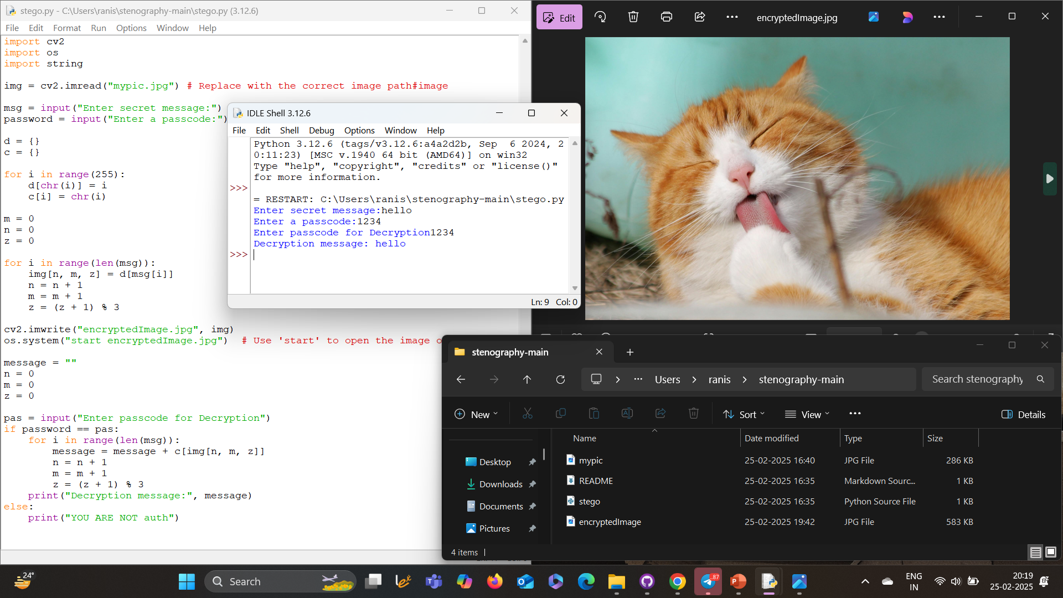
Results

Slide 8
RESULTS (DESCRIPTION)
The following screenshots illustrate the results of the project, with a description of each step below:
Code Execution: The script runs in IDLE to encode and decode hidden messages.
Original Image: An unaltered image used for embedding the secret message.
Encrypted Image: The image with hidden data, appearing unchanged visually.
Decryption Process: Extracting and displaying the hidden message upon entering the correct passcode.

Slide 9
Conclusion
Steganography is a powerful method for secure data transmission without attracting attention.
The project successfully embeds and extracts messages from images using a password-protected approach.
Ensuring security and confidentiality in digital communication is crucial in today's data-driven world.
Future enhancements can further improve the robustness and usability of this technique.

Slide 10
GitHub Link
GitHub Repository: https://github.com/Hemanthkumarsunkari27/Steganography.git

Slide 11
Future scope(optional)
Implementing steganography for other file formats (audio, video, documents).
Enhancing security with AES encryption before embedding.
Developing a GUI-based application for non-technical users.
Cloud-based secure image sharing service.

Slide 12
“Security is not a product, but a process” – Bruce Schneier THANK YOU

